Slide 1
Doing a Land Acknowledgement – Quick Guide
Why do a land acknowledgment? Indigenous people have a long history and connection to the land that is now Canada. It is important that institutions recognize this through practices that support the process of recognition and reconciliation. Doing a land acknowledgement focuses attention on the continuing relationship between Indigenous people and their territory.
How can I do a land acknowledgement? To find out which nation’s traditional and ancestral land you are on, you can go to www.native-land.ca and search by postal code. Write the names of the nations down and practice your pronunciation - it doesn’t have to be perfect. You can use the excellent resource at https://www.first-nations.info/pronunciation-guide-nations-british-columbia.html to guide you.
How can I make it meaningful? Consistent acknowledgment is important to promote awareness and reinforce Indigenous presence, but it is also important to ensure that a land acknowledgment is a meaningful act. You can do this by:
Clicking on the links at www.native-land.ca and learning about the individual nations, their culture, their language, and their history
Sharing some of this knowledge/information during your land acknowledgement as a way to make Indigenous stories visible
Asking yourself questions about land acknowledgements and reflecting on how they made/make you feel
Thinking about your relationship to the land and then sharing this during your session – consider including a photo as a Zoom background or in your PowerPoint to visually situate yourself
Notes:
This resource has been created in consultation with CTLT Indigenous Initiatives, the UBC Faculty of Medicine Communications Team, and the Centre for Excellence in Indigenous Health.
NOTE: Correct pronunciation of Syilx Okanagan Nation is not included in the pronunciation guide.
Syilx Language House (http://www.thelanguagehouse.ca/) models correct pronunciation:
http://www.thelanguagehouse.ca/uploads/6/1/3/8/61381143/syilx_mkj_may_2021.mp3

Slide 2
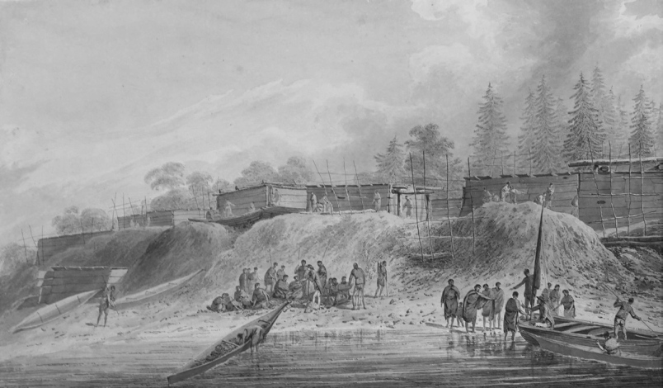
Doing a Land Acknowledgement – Quick Guide
“When I was researching the Nuu-chah-nulth Nations on the west coast of Vancouver Island, I was interested to learn that, for 200 years, they were known as the Nootka People. While there are different versions, Chief Mike Maquinna recounted that, when Captain Cook was greeted by the Mowachaht, he was welcomed with ‘nu.tka.?icim’, which means ‘sail around’ in Nuu-chah-nulth. He was directing Cook to the harbour in front of the village, but Captain Cook misunderstood and named the place – and the people - Nootka.”
(Sketch: John Webber, Habitations in Nootka Sound, 1778.)
Be authentic. It’s normal to feel awkward or uncomfortable at first. It’s not supposed to be perfect or even rehearsed, it’s supposed to be genuine. Mistakes in things like pronunciation are part of the learning process and even talking about the process you went through to prepare your land acknowledgement can be an entry point for discussion. A land acknowledgement is the beginning of a larger dialogue and sharing your thoughts helps to start the conversation.

Slide 3
I am in Port Alberni and I would like to acknowledge that I’m on the traditional, ancestral and unceded territories of the Nuu-chah-nulth people including:
Hupacasath (Who-petch-as-set)
Tseshaht (Tse-shat)
What is your relationship to the land or territory that you’re on?
Notes:
To find the names of the nation whose land you are on, search by postal code at www.native-land.ca
Write the names of the nations in the text box on the slide and click on the names of the individual nations to find a link to their websites to explore for more information on history, culture,
Use https://www.first-nations.info/pronunciation-guide-nations-british-columbia.html to help you with accurate pronunciation.
Click on the icon to add a photo of your immediate area, a historical photo or another image to add context to your acknowledgement. Try to find the name of the local language or language group and use the indigenous name for the location shown in the photo.
You can go to www.native-land.ca and click the ‘Languages’ button to see which language is spoken in your area. Un-clicking the ‘Territories’ overlay will make it easier to find.
Share a reflection about the land or territory you’re on, or you can also consider sharing your thoughts on one of the following questions:
What is something that I have learned about the history, culture or language of the people and the land?
Why is this land acknowledgement happening?
What did I think about the first time I heard a land acknowledgement?
How do I feel when I give a land acknowledgement? Has that changed over time?
What was the process I went through to prepare this land acknowledgement?
How does my evolving understanding of Indigenous presence relate to my work and practice?
As a starting point, you can build on this example of an acknowledgement that recognizes the institutional relationships that exists at UBC:
I would like to acknowledge that UBC’s Vancouver campus is situated on the traditional, ancestral, unceded territory of the Musqueam people, and UBC Okanagan is situated in the territory of the Syilx Okanagan Nation and their peoples. I would also like to acknowledge that you are joining us today from many places, near and far, and acknowledge the traditional owners and caretakers of those lands.
- Created by UBC Ceremonies and Events in consultation with colleagues at Musqueam and the Syilx Okanagan Nation

